Slide 1

Building an Image Segmentation Model for a CV System
Presented by: Octave Antoni
Last Updated: November 5th, 2022

Slide 2
Table of contents
Introduction
Image data Processing
Image Segmention
Deploying the model
Conclusion

Slide 3
Introduction
Main goal ➔ Create an Image Segmentation Model that will be used in a Computer Vision System used by a Self-Driving Vehicle.
Use of the Cityscrapes dataset
Segmentation of images by Category
Key points :
Implementation of the model in the Keras framework
Deployment of an API and of a visualization application on Flask/Heroku
Redaction of a technical note to delve deeper into technical details
Limitation : Azure Credits not provided to student ➔ Only low performance computes could be used (trial account) ➔ Low number of training epochs and high training time

Slide 4
Image Data Processing

Slide 5
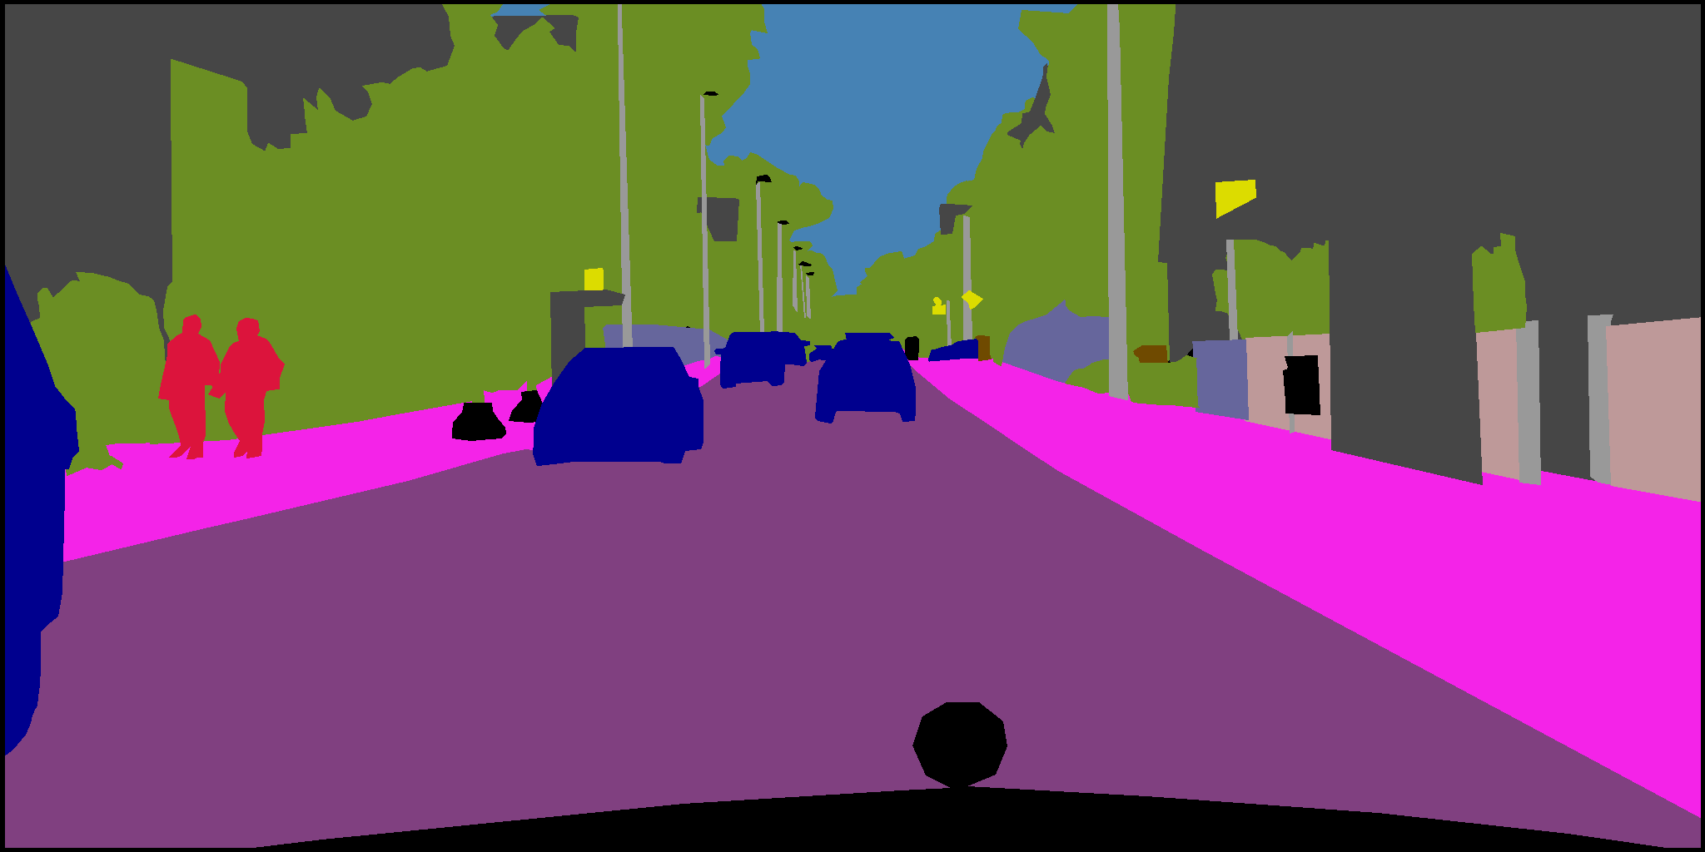
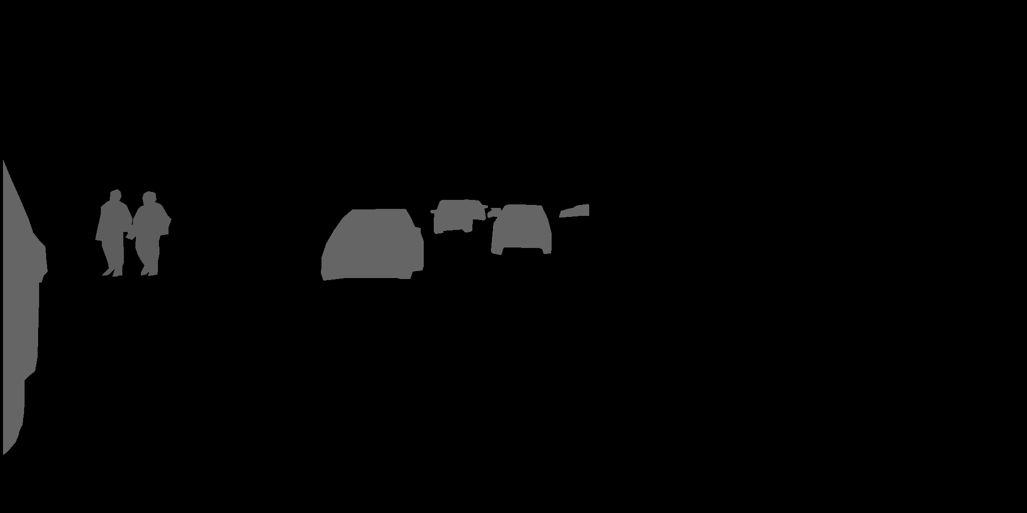
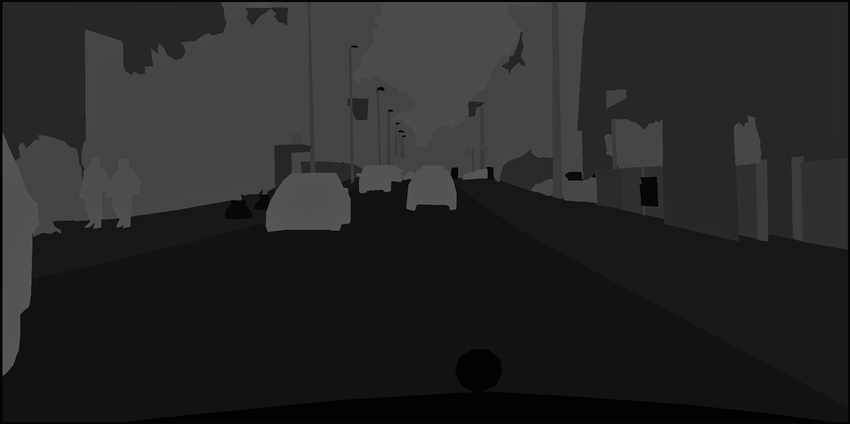
Dataset
Cityscrapes dataset:
5000 labelled photos
Fixed 1024*2048 size
Downloading from the source requires .edu email adress
Invalid test masks ➔ 3475 valid photos
4 types of mask data:
Colored masks using custom RGB scale
Masks labelled with instance ID of certain type of objects
Semantic Labelled masks ➔ Used for the project
Json file with segment and instance coordinates
Colored
Mask
Instance Id
Labelled
Mask
Class Id
Labelled
Mask

Slide 6
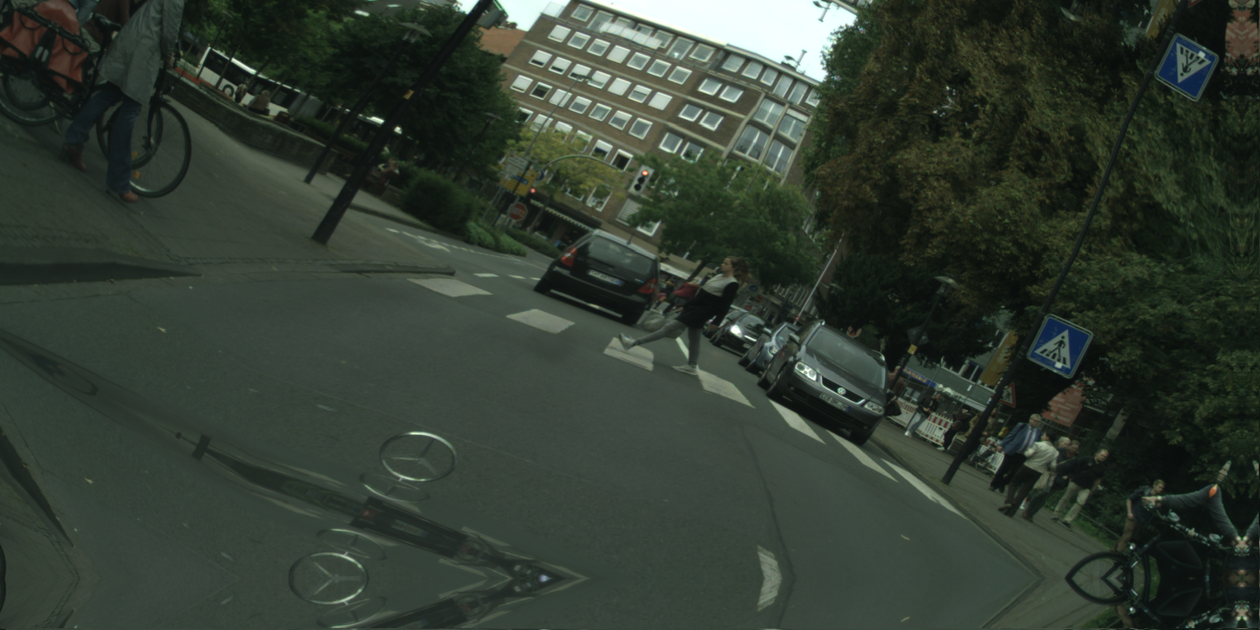
Image Data Preprocessing
Base Image
Copy
Copy
Reduction of shape to 256x256 ➔ 256x512 (preservation of aspect ratio)
Image Normalization with encoder preprocessing function
One-hot encoding mask labels (converting 1024x2048 masks to 1024x2048x3 arrays)
Testing of different data augmentation techniques:
No data augmentation applied
Data augmentation within pipeline
Using Albumentations to create additional augmented samples
➔ 3 times the number of initial samples
Horizontally Flipped Image
Base Image
Rotation (max 30°, p=0.5)
Random Brightness OR Contrast (p=0.7)
Elastic Transform OR Grid Distortion (p=0.5)
Flipped Augmented Image
Unflipped Augmented Image
Base Image

Slide 7
Deep Learning Image Segmentation

Slide 8
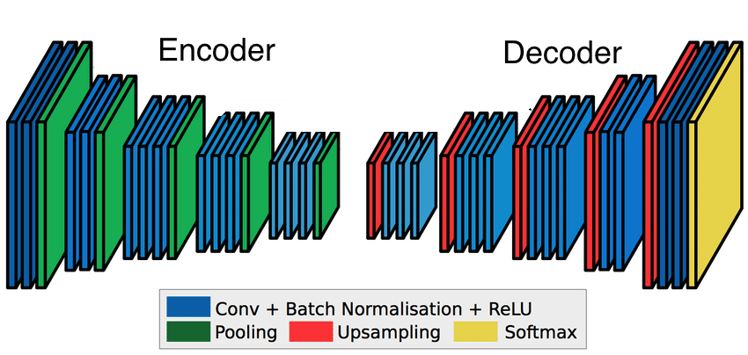
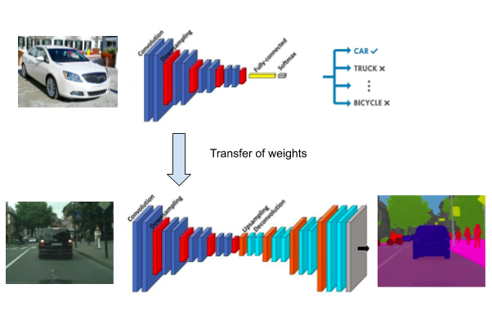
Image Segmentation principles
Semantic Image Segmentation
Use of Convolutional Neural Networks (CNN)
Performance Metrics : Dice Coefficient – Intersection over Union (IoU) – Mean One-Hot
Other metric : shape of the predicted masks
Optimizer : Adam – Adam Weighted (AdamW)
Loss : Cross-Entropy – Dice Loss
Use of skip connections to prevent the loss of low-level information
Transfer learning for encoder necessary ➔ reduce computation time

Slide 9
State of the Art
Semantic Image Segmentation
Use of Convolutional Neural Networks (CNN)
Performance Metrics : Dice Coefficient – Intersection over Union (IoU) – Mean One-Hot
Other metric : shape of the predicted masks
Optimizer : Adam – Adam Weighted (AdamW)
Loss : Cross-Entropy – Dice Loss
Use of skip connections to prevent the loss of low-level information
Transfer learning for encoder necessary ➔ reduce computation time

Slide 10
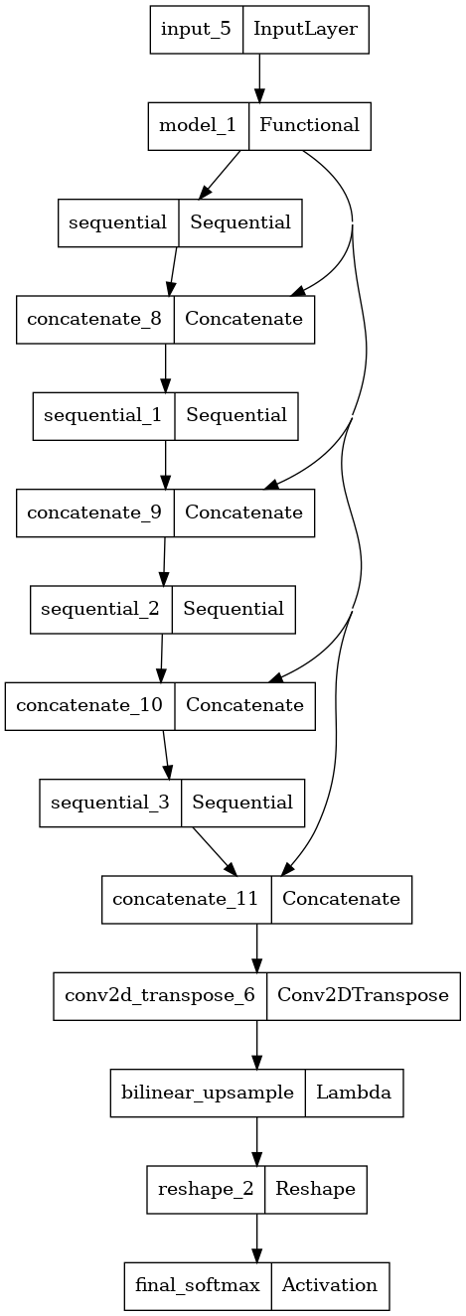
Proposed Model
Encoder used : MobileNetV2 loaded with ImageNet weights
Decoder : Modified version of UNet
Use of skip connections between 4 MobileNetV2 layers and UNet upsamplers
Different versions tested:
256x256 and 256x512 image size
With or without data augmentation
JaccardLoss / Categ. CrossEntropy
Final Dice Score : Mean IOU :
Accuracy :

Slide 11
Cloud based Model Deployment

Slide 12
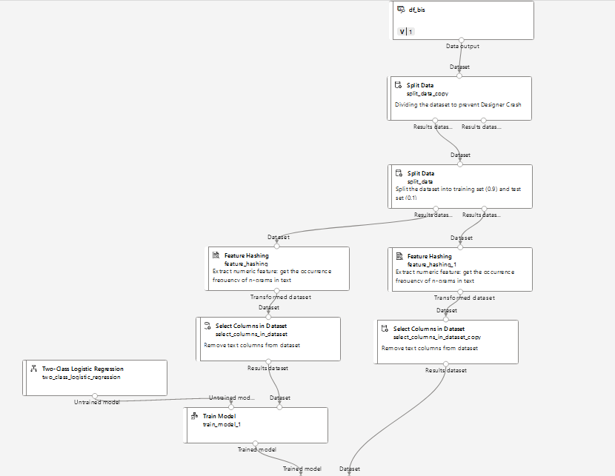
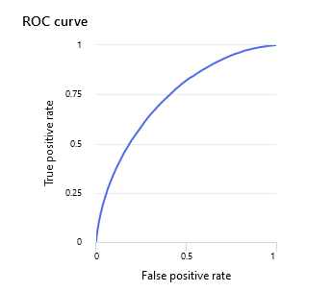
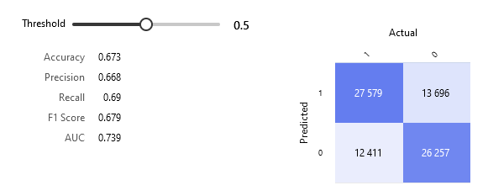
Basic Model Implementaiton
Reducing Dataset
to Prevent Crashes
Using Azure ML Designer
Loaded lemmatized Dataset to reduce computation time
Necessity to reduce the number of rows of the dataset to prevent crashes (50% used).
Performed Bigram Feature Hashing of text
Used Logistic Regression Model
Final Accuracy = 0.67
ROC : 0.74, F1 Score : 0.68
Test/Train Split
Bigram Feature
Hashing
Logistic Regress.
Training and Scoring
Accuracy 0.673

Slide 13
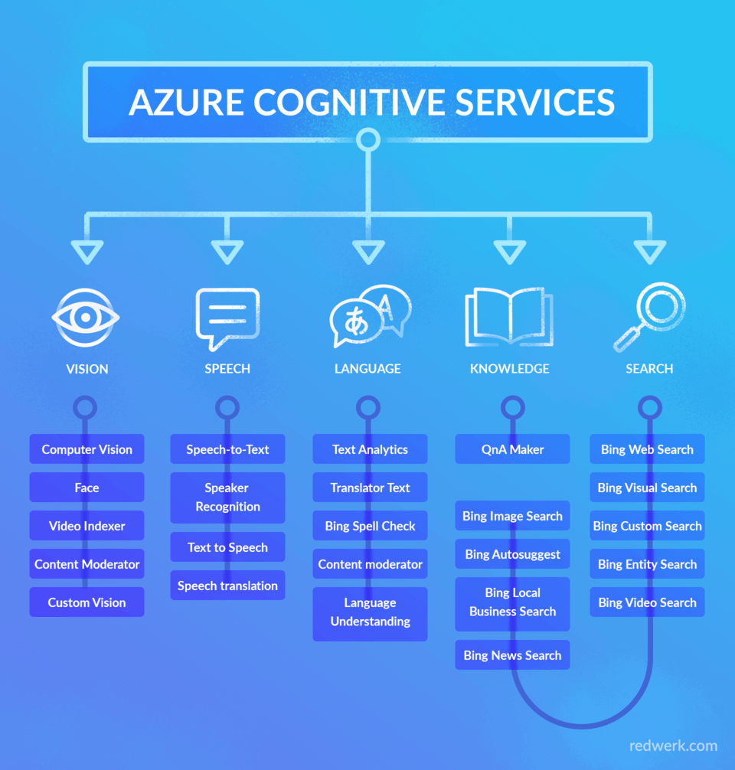
Commercial off-the-shelf API
Creation necessary of Azure Cognitive Service account
Maximal request size : 10 documents / request
Free up until 5000 requests / months, paying tier above
Big advantage : Very fast classification
Good Accuracy ➔ 0.76
ROC : 0.76, F1 Score = 0.78

Slide 14
Conclusion

Slide 15
Conclusion
During this project, Sentiment Analysis has been performed on Twitter posts.
Recommendations :
Reconsider using commercial API ➔ moderate accuracy (0.76) for high price.
Basic Model with Designer ➔ low accuracy (0.67), consider using a simple Deep Learning Model instead
Use BERT model + RNN for Advanced Customizable Model
Improve current model with more training epochs and better compute instances
Implement BERT model to create a Dashboard of the polarity of current tweets about Air Paradis

Slide 16
Questions?

